Slide 1
CS3210 Lab 2
Parallel Programming with OpenMP & Performance Instrumentation
Slides inspired by Sriram's slides

Slide 2
Feedback from Lab 1
Copied code from semaph-named.cpp, why is my code getting segfault?
Use-after-free bug in our code, I had shared with the rest of the teaching team. (hopefully those who did not ask me about the bug had moved to using unnamed semaphores…)
Sorry, should have made an announcement about this bug earlier too 😓
Too time consuming :(
Do not be shy to PM me for help if you get stuck!
Start your labs/assignments earlier so you won't run into "rush hour" of lab machines.
Lab 2 is simpler than Lab 1 (due to quiz + assignment releasing on the same week 🥲)

Slide 3
"the dangling pointer" (Out of Syllabus, FYI only)
#include <cstdlib>
#include <iostream>
#include <cstring>
using namespace std;
int main() {
int r = rand();
string name = ("pSem-" + std::to_string(r));
printf("%s\n", name.c_str());
const char* name_cstr = name.c_str();
printf("%s\n", name_cstr);
const char* dangling_ptr = ("pSem-" + std::to_string(r)).c_str();
const char* new_name_cstr = ("pSem-" + std::to_string(r)).c_str();
printf("%s\n%s\n", dangling_ptr, new_name_cstr);
}
Compile with g++ and run this code a few times.

Slide 4
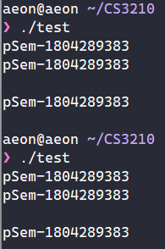
"the dangling pointer" (Out of Syllabus, FYI only)
3rd print statement is always empty, why?
Take a look at the following line: const char* dangling_ptr = ("pSem-" + std::to_string(r)).c_str();
"pSem-" + std::to_string(r) creates an unnamed (temporary) string variable.
c_str() returns a pointer to the unnamed string.
The unnamed string gets deallocated ('freed') by C++ during the declaration of new_name_str in the next line.
The dangling_ptr pointer no longer points to a valid string (dangling pointer), thus causing a use-after-free bug.
Using this garbage string as your semaphore name leads to unspecified behaviour (i.e. segfaults)

Slide 5
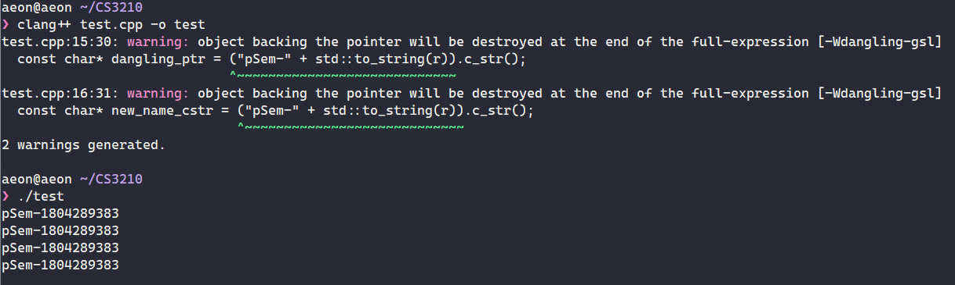
Different compiler behaviour? (also FYI)
Fun fact: clang will actually warn about this behaviour, and results in a program that runs differently!
This is outside of the scope of CS3210, we delve more into the programming language behaviour in CS3211 👀

Slide 6
Heads up: Assignment 1 - Releasing tomorrow (tonight?)
Recommend working in teams of 2
Parallelizing a simulation with OpenMP
Using GitHub Classroom to manage and submit your code
Due 2 weeks after release of assignment doc (Wed 27 Sept, 2pm)
Advice: Complete Lab 2 first to get the hang of OpenMP first :)

Slide 7
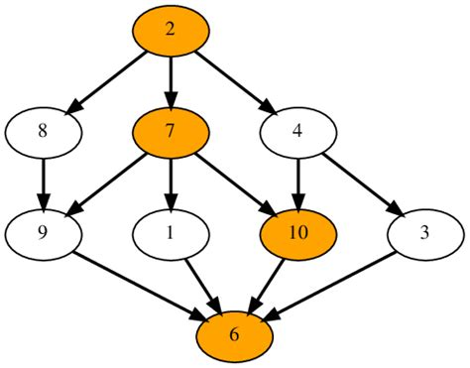
Recapping the past week
Parallel Programming Models I (Lec 4 & Lab 2)
Data vs Task Parallelism
Coordination models
Shared address space
Data parallel
Message passing
Task Dependence Graphs
Foster's Design Methodology
Partitioning ⬇️ Communication ⬇️ Agglomeration ⬇️ Mapping
Parallel Patterns
Fork-join
Parbegin-Parend
SIMD/SPMD
Master-Worker
Task Pools
Producer-Consumer
Pipelining

Slide 8
Focus: OpenMP
What kind of parallel pattern does OpenMP use?
Fork-Join
Client-Server
Task pool
Producer-consumer
Parbegin-Parend

Slide 9
Focus: OpenMP
What kind of parallel pattern does OpenMP use?
Fork-Join (Mainly how OpenMP works in the backend)
Client-Server
Task pool
Producer-consumer
Parbegin-Parend (Mainly what you, as a programmer, will do in your code)

Slide 10
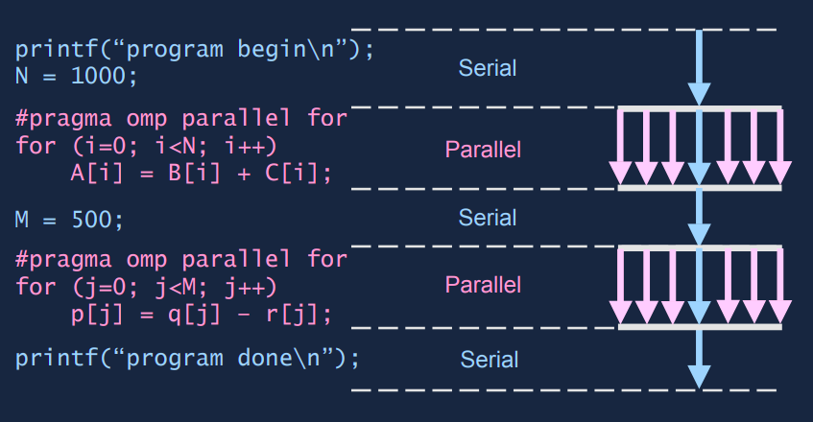
Focus: OpenMP

Slide 11
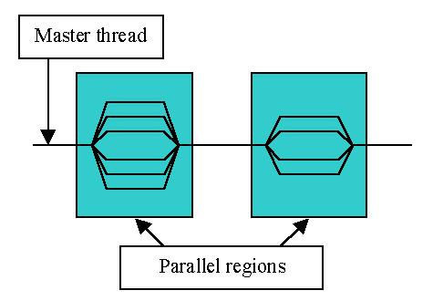
What is OpenMP?
Compiler directives that help you parallelize parts of your code easily!
TLDR usage: Add "#pragma omp …" lines above your parallelizable code.

Slide 12
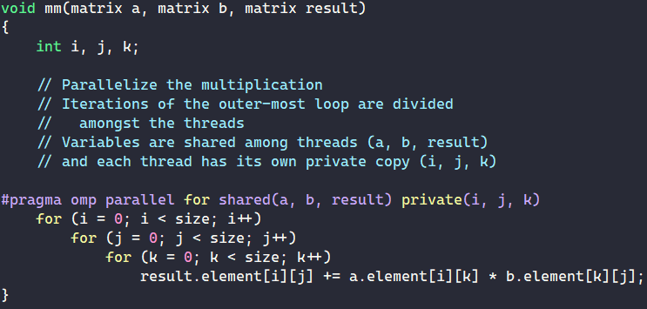
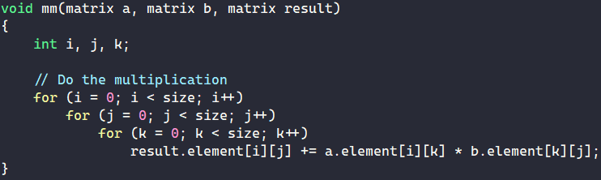
What is OpenMP?
Main usage: Parallelize for loops!
Use #pragma omp to tell the compiler to generate parallel code for the code block below.
All threads will wait for each other before continuing (implicit barrier).
Sequential (mm-seq.cpp)
OpenMP (mm-omp.cpp)

Slide 13
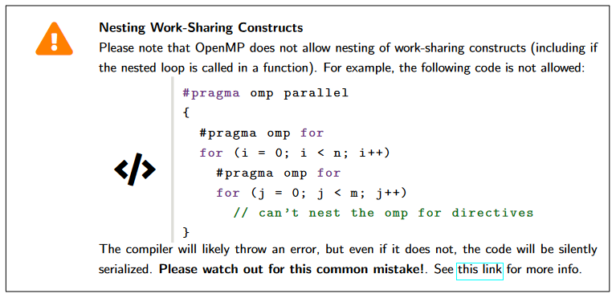
Warning against OpenMP Nesting

Slide 14
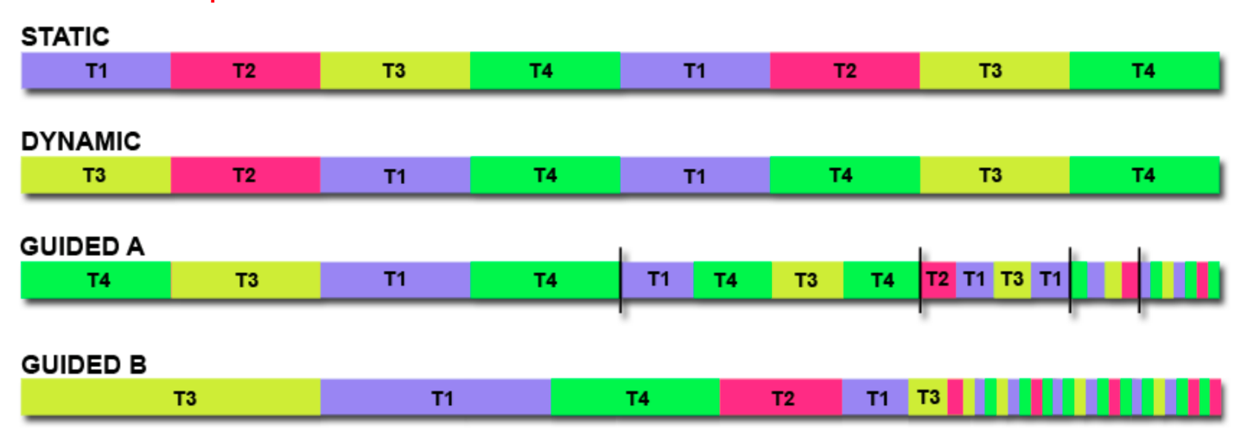
Focus: OpenMP
We can control how loop iterations are given to threads.
Static: Array is split into equal chunks, each thread is pre-allocated a fixed chunk of the array in round-robin fashion (least overhead)
Dynamic: Fixed size chunks are dynamically allocated to idle threads during runtime (for unpredictable work times)

Slide 15
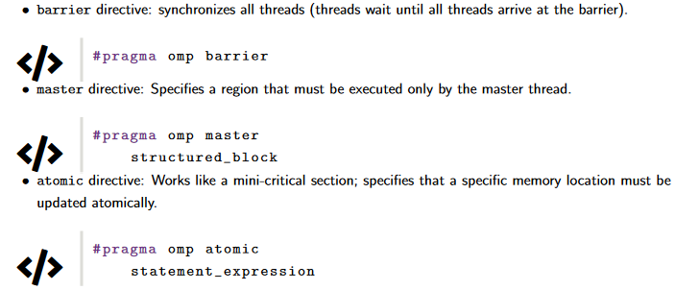
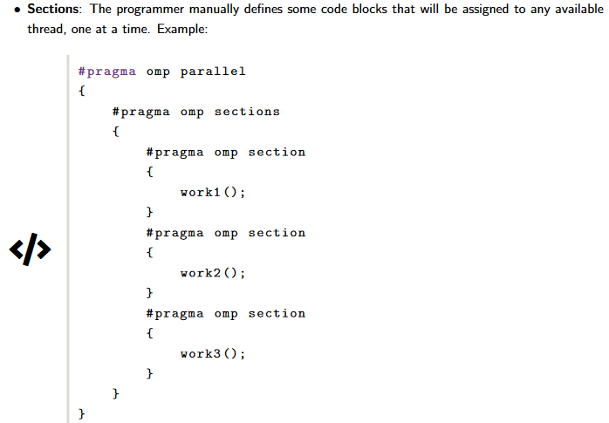
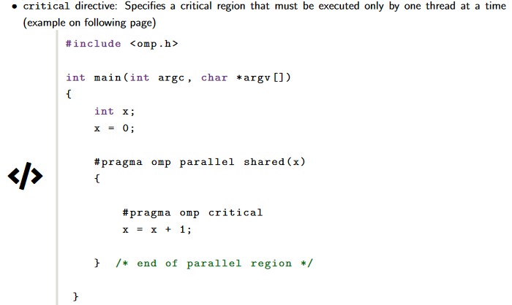
Focus: OpenMP
Useful constructs for your exploration here & in Assignment 1:

Slide 16
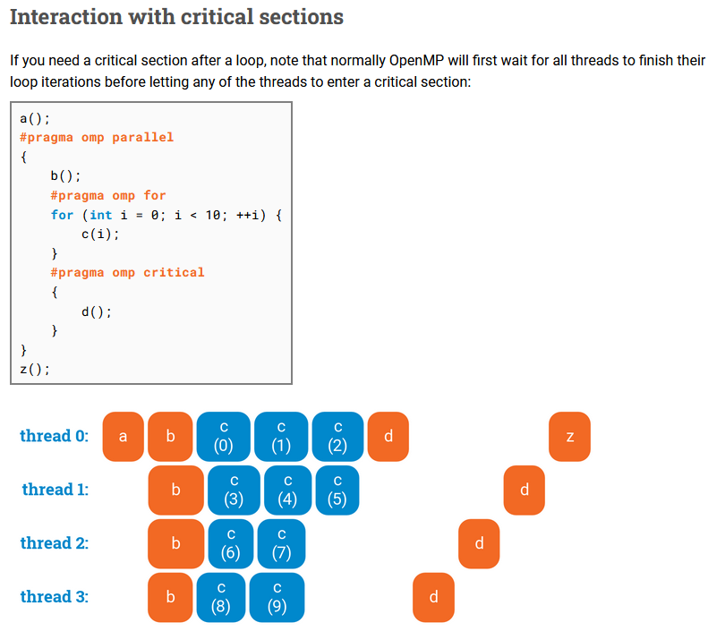
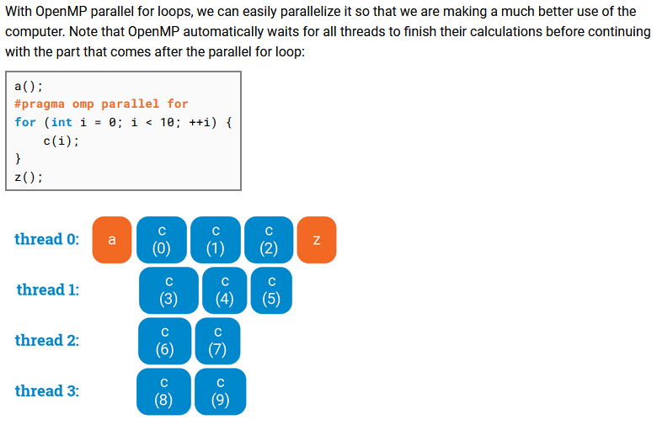
Very cool visual guide!
https://ppc.cs.aalto.fi/ch3/ (link should be in your lab sheet - bottom of Page 7)

Slide 17
perf

Slide 18
What is perf?
Unified interface to collect performance statistics from Linux from 2 sources:
Hardware counters (from performance measurement unit [PMU])
e.g. cache misses, branch misses, instructions, …
Software counters (provided by Linux kernel)
e.g. page faults, cpu-migrations, …

Slide 19
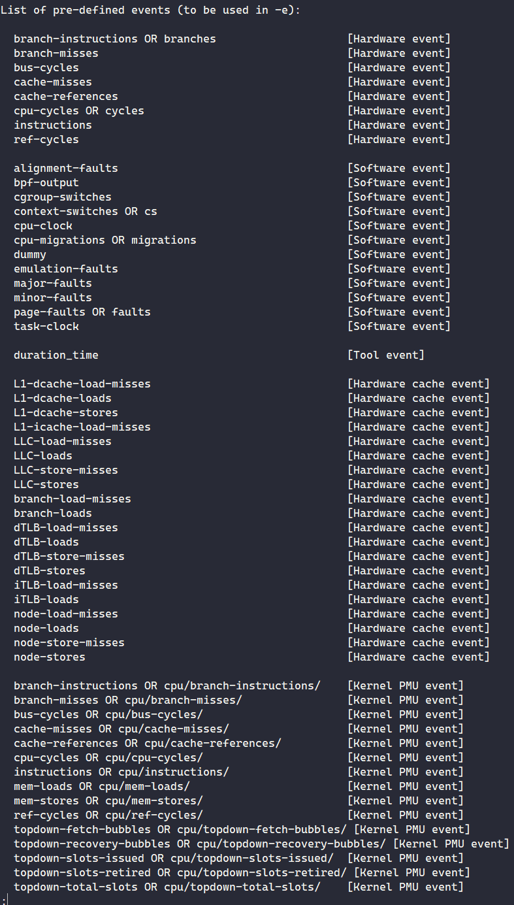
perf events
Get list of events that perf can measure via perf list
Differs for Linux kernels + Hardware types
Example usage: perf stat -- ls
Do not be too alarmed by the huge list of events - the lab sheet will guide you to measure events that are more important for this course.

Slide 20
Live Demo: Tut 1's pthread_addsub results
4 Core/8 Thread i7-7700 CPU @ 3.60GHz: 3.370s
8 Core/8 Thread i7-9700 CPU @ 3.00GHz: 4.000s
10 Core/20 Thread Xeon Silver 4114 @ 2.20GHz: 4.611s
Why does it run the fastest on i7-7700?

Slide 21
Live Demo: Tut 1's pthread_addsub results
For me:
vim pthread_addsub.cpp
g++ -o pthread_addsub pthread_addsub.cpp
srun -p i7-7700 perf stat -- ./pthread_addsub
srun -p xs-4114 perf stat -- ./pthread_addsub

Slide 22
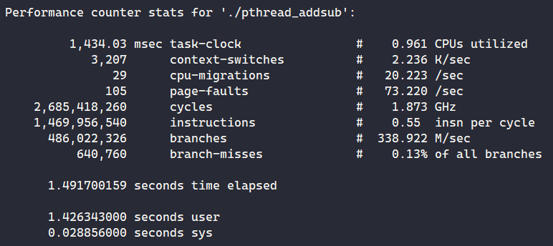
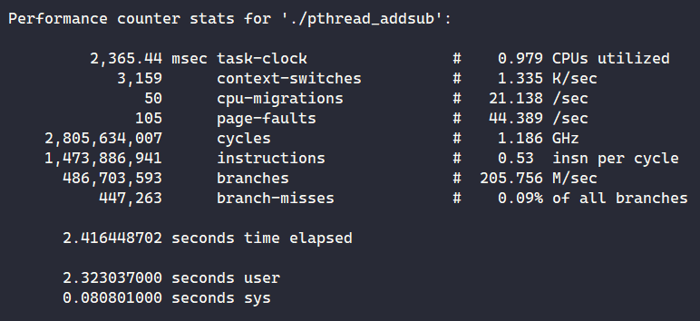
Live Demo: Tut 1's pthread_addsub results
No speed-up despite using multiple threads :(
note: "CPUs" here refers to processing cores
i7-7700 @ 3.60Ghz
xs-4114 @ 2.20GHz
i7-7700 wins due to higher clock speed (& thus having higher single-threaded performance)

Slide 23
Today's Problem: Matrix Multiplication
Can you see how it can be parallelized?

Slide 24
Getting started
Do everything in your NFS home!
/nfs/home/e0xxxxxx directory
Reminder: quick access with cd /nfs$HOME
wget the lab from pdc (link in PDF)
Please use srun or sbatch to run your programs from Ex3 and onwards.

Slide 25
Lab time!
Ex1 + Ex2: Matrix Mult w/ OpenMP
Ex3: System differences w/ OpenMP
Ex4: Static vs Dynamic schedules
Ex5: OpenMP sections
Ex6: Synchronization in OpenMP
Ex7: Profiling w/ perf
Ex8 + Ex9: perf w/ Slurm
Ex10: IPC & MFLOPS vs no. of threads
Ex11: Matrix Mult optimization
Ex12: Benchmarking Ex11
Quick taste of OpenMP
OpenMP exercises
perf exercises
(Some tidbits provided later)
For submission (by next Wed 2pm)
Notes:
Demo ex9 at the end

Slide 26
perf subsampling

Slide 27
Live Demo: perf -M vs perf -e
perf -M
perf stat -M GFLOPs python3 -c 'print(2.0 / 5.0)'
srun -- hostname; perf stat -M GFLOPs python3 -c 'print(2.0 / 5.0)'
Run multiple times
perf -e
perf stat -e fp_arith_inst_retired.scalar_double python3 -c 'print(2.0 / 5.0)'
srun -- hostname; perf stat -e fp_arith_inst_retired.scalar_double python3 -c 'print(2.0 / 5.0)'
Run multiple times
What is causing this inconsistency?

Slide 28
Live Demo: perf -M vs perf -e
What if we try replicating perf -M with perf -e?
perf stat -e fp_arith_inst_retired.scalar_single,fp_arith_inst_retired.scalar_double,fp_arith_inst_retired.128b_packed_double,fp_arith_inst_retired.128b_packed_single,fp_arith_inst_retired.256b_packed_double python3 -c 'print(2.0 / 5.0)'
What happens?

Slide 29
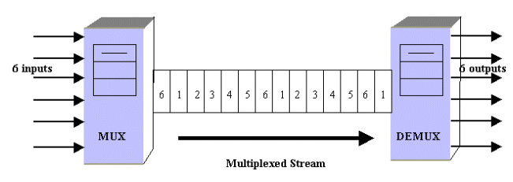
Live Demo: perf -M vs perf -e
If there are not enough hardware counters: perf multiplexes the events (i.e. subsampling) and estimates the counts based on execution time!

Slide 30
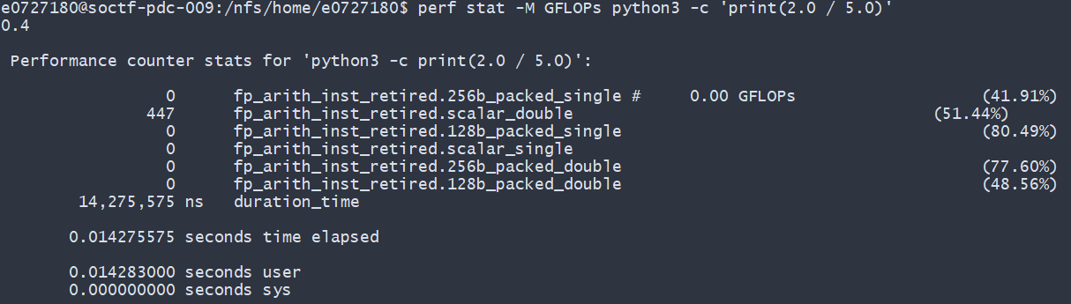
% sign in perf readings
Usually means that the reading is subsampled.
Signifies % of time spent measuring the specific event.
https://stackoverflow.com/questions/33679408/perf-what-do-n-percent-records-mean-in-perf-stat-output

Slide 31
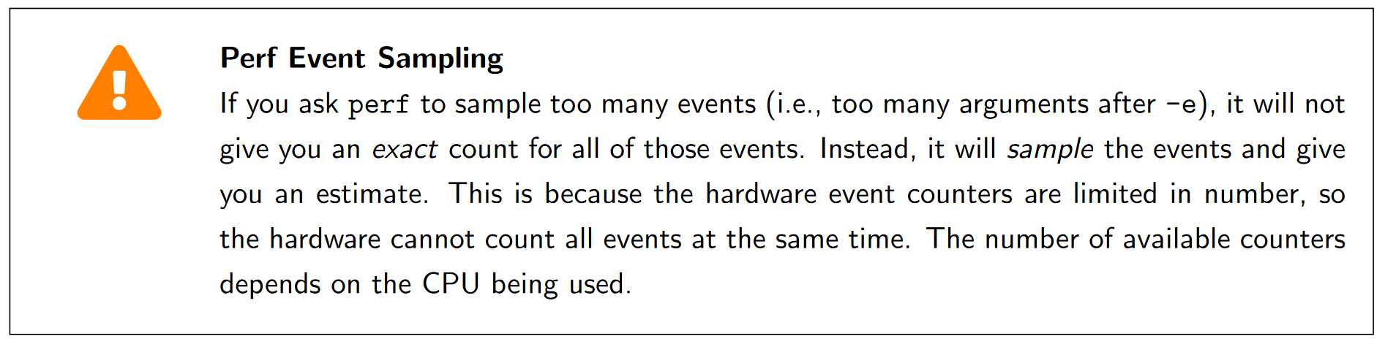
perf subsampling
Basically a warning to prevent what happened in the previous slides

Slide 32
Disclaimers for Ex 11: Optimizing matrix multiplication
We are not concerned about correctness.
The values for the matrices are generated randomly.
There is NO NEED to transpose the matrices!
There are multiple solutions possible.
As long as the order of access fulfills the criteria of row-wise access.

Slide 33
Summary
OpenMP
perf usage
Using Slurm with OpenMP and perf

Slide 34
End of Lab 2
Slides are uploaded here after every session GDrive: drive.zhiheng.dev
Anonymous Feedback: feedback.zhiheng.dev
Tutorial 2 forecast: ~1 hr 30 mins

